Slide 1
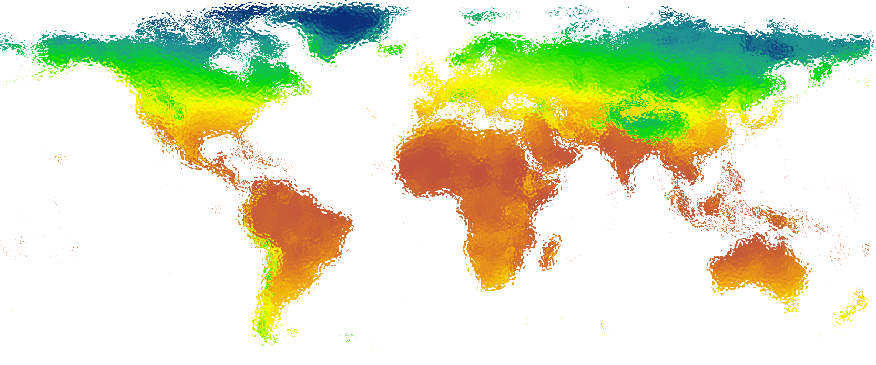

Practical Uses of Species Distribution Models:
Forecasting
Leon Marshall
December 8th, 2017

Slide 2

forecast
Verb
1.
predict or estimate (a future event or trend)

Slide 3
Why forecast species distributions?
Notes:
We need to predict howclimate changewill
alter biodiversity if we are to prevent
serious damage to the biosphere (1). Biologists
develop predictivemodels to anticipate
how environmental changesmight
affect the future properties of species and ecosystems
(2, 3).Manymodels have been developed
to understand climate change impacts (fig. S1) (4),
but biological responses remain difficult to predict
(5, 6).

Slide 4
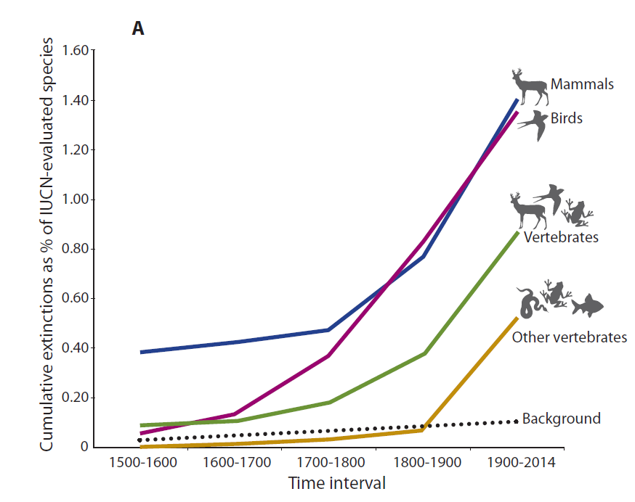
Biodiversity loss
Ceballos et al., - Accelerated modern human–induced species losses: Entering the sixth mass extinction - 2015 - Science

Slide 5
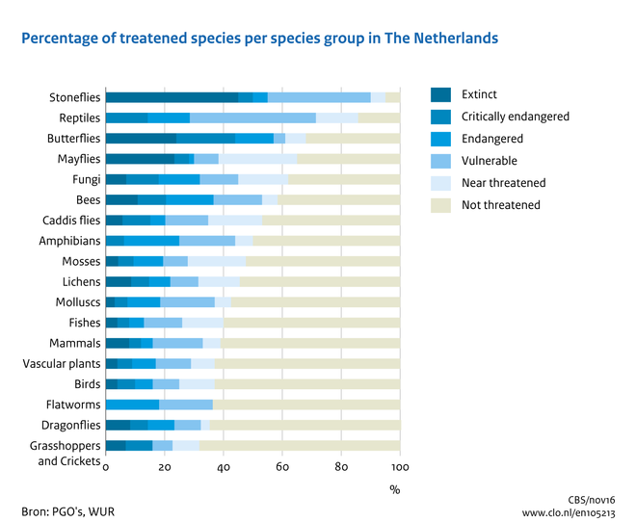

Slide 6
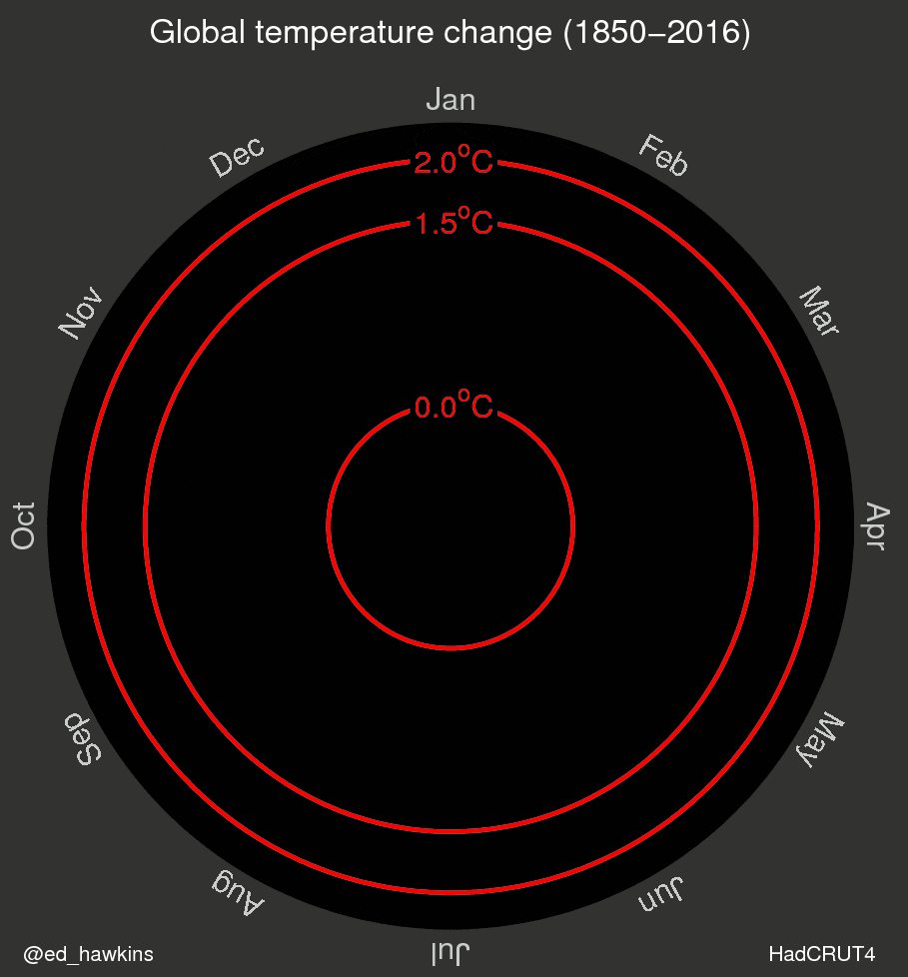
Global Change

Slide 7
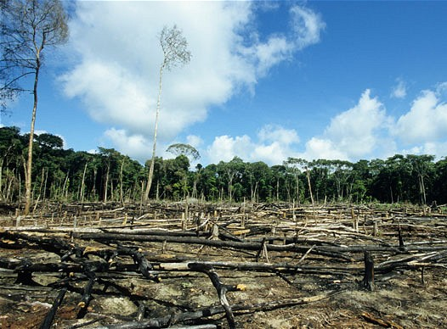
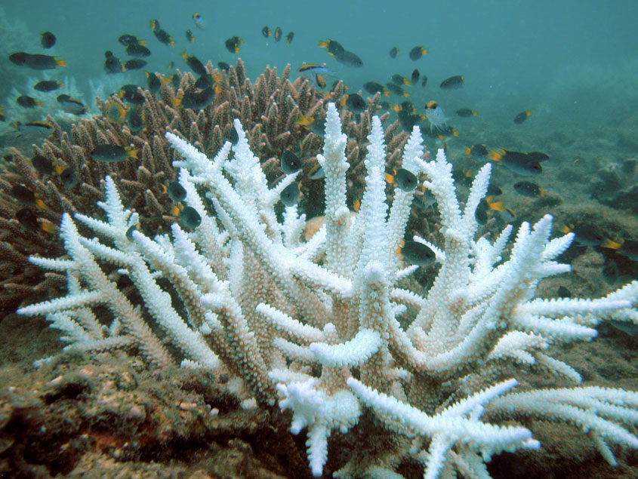
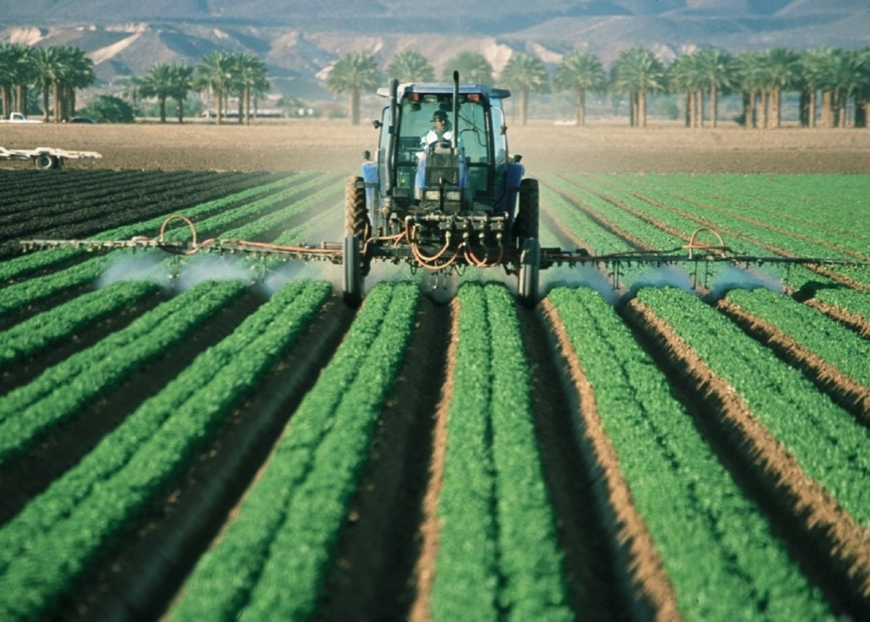
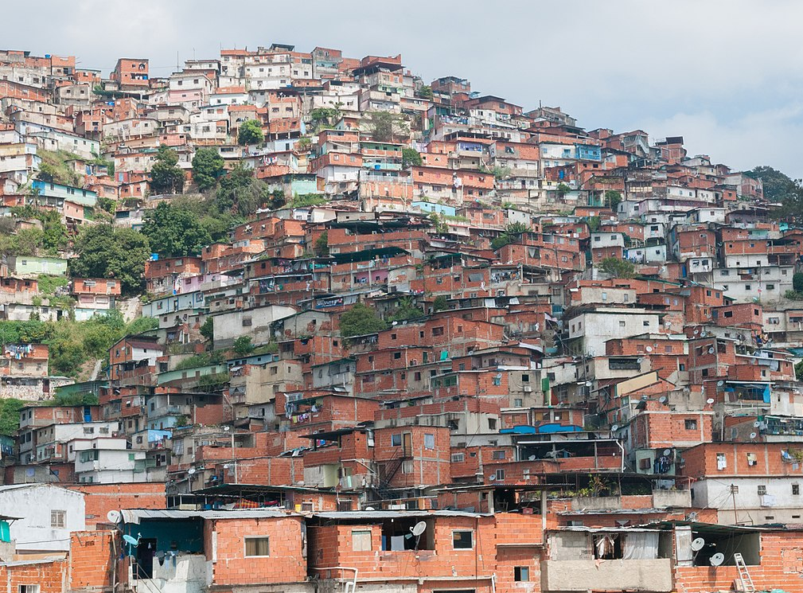

Slide 8
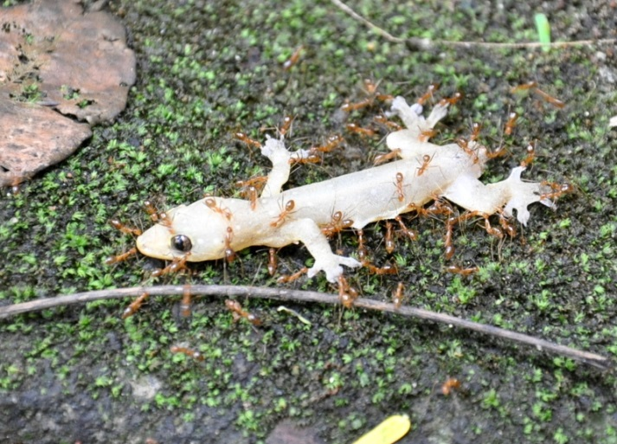
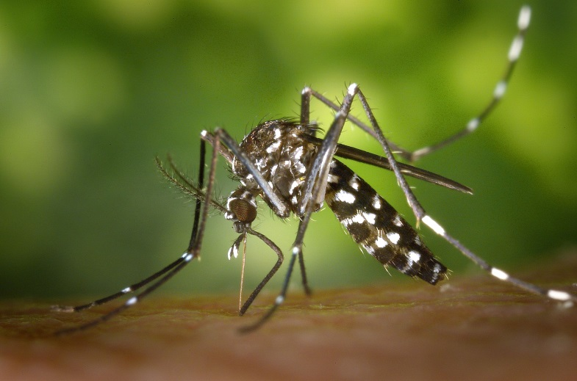
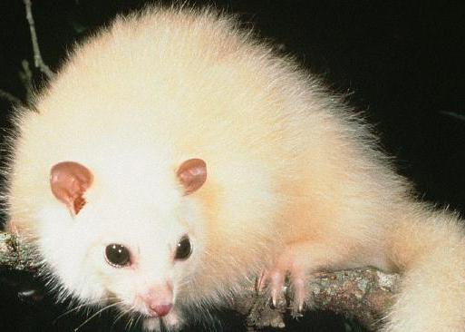
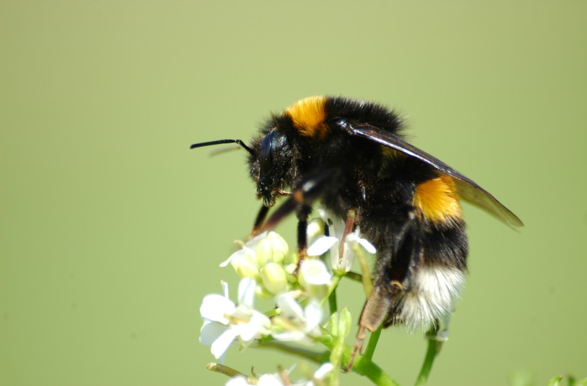
Invasive
Disease vectors
Endangered
Crop pollinators
Notes:
white lemuroid ringtail possums

Slide 9
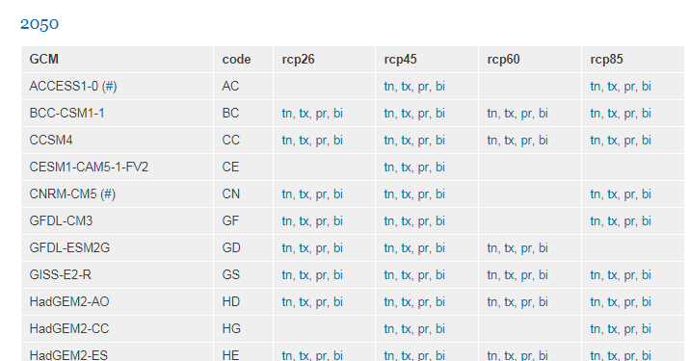
Climate models
Model the interactions between the atmosphere, oceans, land surface, ice – and the sun.
Can they reproduce the past and predict the future?

Slide 10
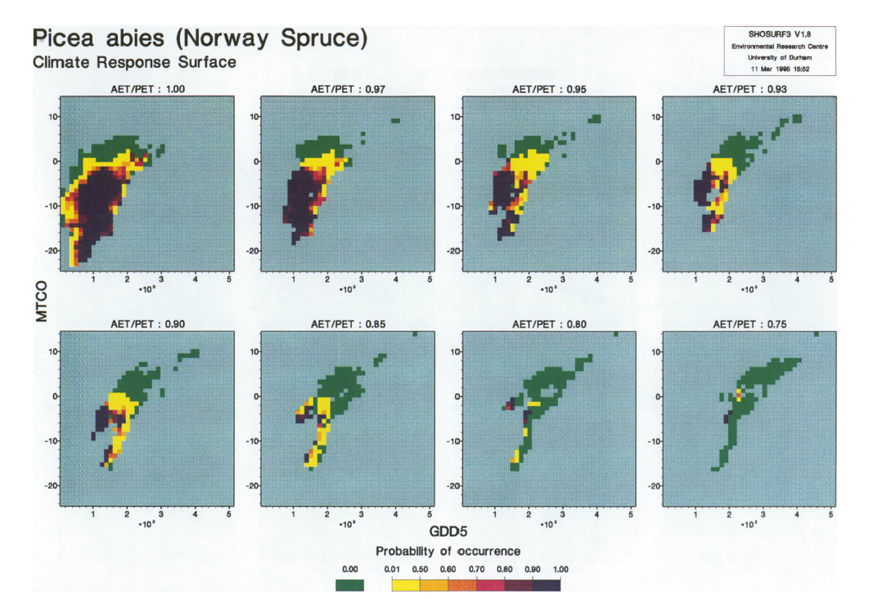
Bioclimatic envelope modeling
Huntley et al., 1995 - Modelling Present and Potential Future Ranges of Some European Higher Plants Using Climate Response Surfaces - Journal of Biogeography
Notes:
Why so many models?
Different climate models, meanwhile, provide alternative representations of the Earth’s response to those forcings, and of natural climate variability. Together, ensembles of models, simulating the response to a range of different scenarios, map out a range of possible futures, and help us understand their uncertainties.
Predicting socioeconomic development is arguably even more difficult than predicting the evolution of a physical system. It entails predicting human behaviour, policy choices, technological advances, international competition and cooperation. The common approach is to use scenarios of plausible future socioeconomic development, from which future emissions of greenhouse gases and other forcing agents are derived. It has not, in general, been possible to assign likelihoods to individual forcing scenarios. Rather, a set of alternatives is used to span a range of possibilities. The outcomes from different forcing scenarios provide policymakers with alternatives and a range of possible futures to consider.

Slide 11
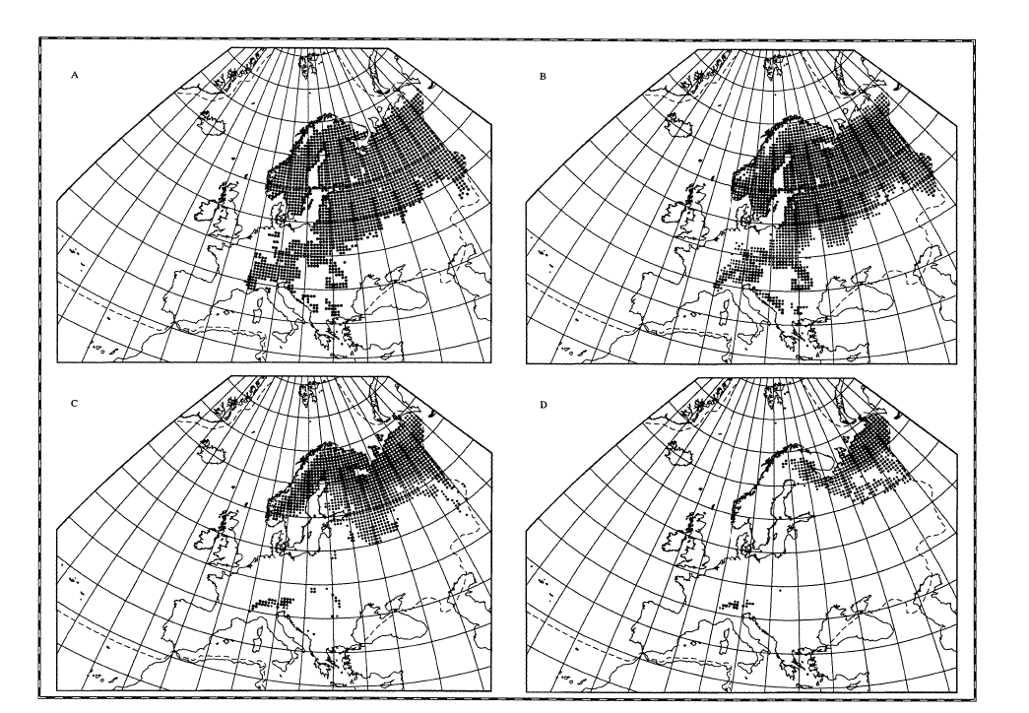
Bioclimatic envelope modeling
Notes:
Why so many models?
Different climate models, meanwhile, provide alternative representations of the Earth’s response to those forcings, and of natural climate variability. Together, ensembles of models, simulating the response to a range of different scenarios, map out a range of possible futures, and help us understand their uncertainties.
Predicting socioeconomic development is arguably even more difficult than predicting the evolution of a physical system. It entails predicting human behaviour, policy choices, technological advances, international competition and cooperation. The common approach is to use scenarios of plausible future socioeconomic development, from which future emissions of greenhouse gases and other forcing agents are derived. It has not, in general, been possible to assign likelihoods to individual forcing scenarios. Rather, a set of alternatives is used to span a range of possibilities. The outcomes from different forcing scenarios provide policymakers with alternatives and a range of possible futures to consider.

Slide 12
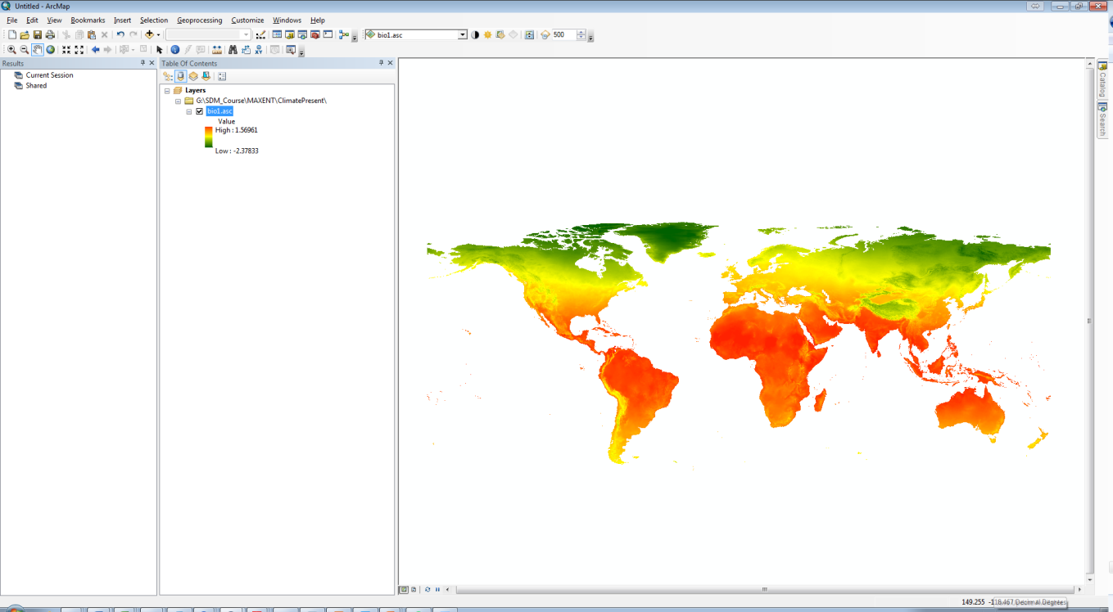
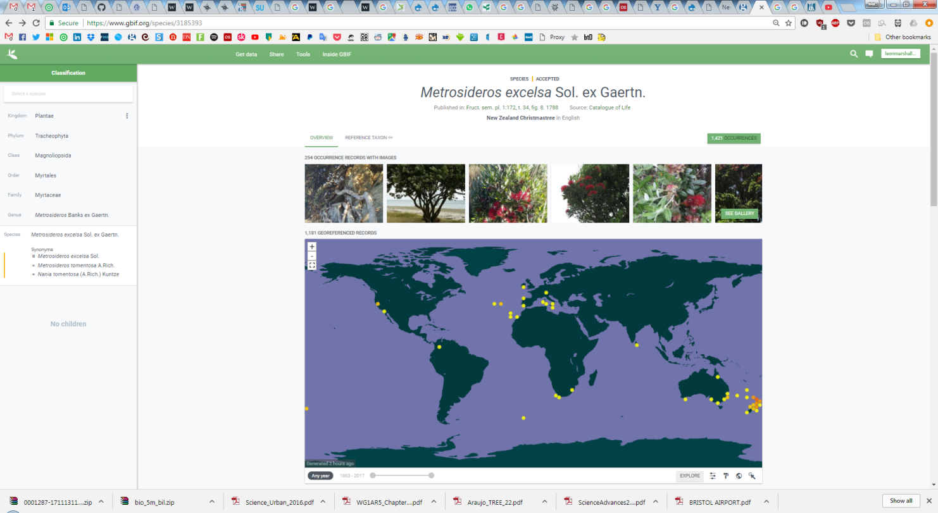
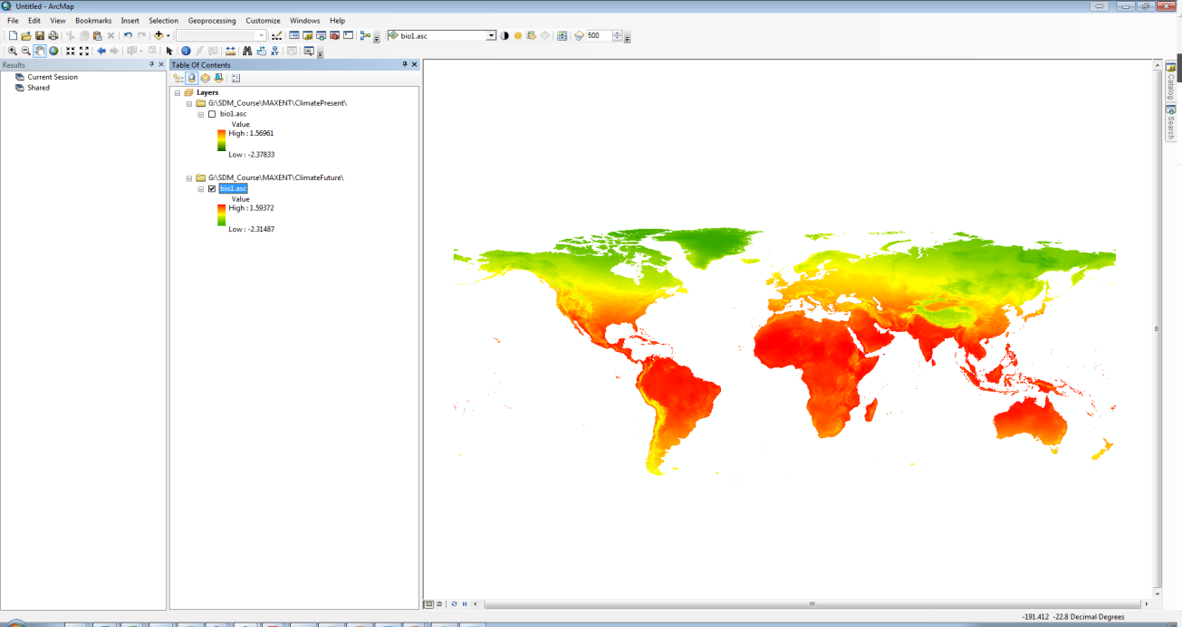
Present Climate
Occurrences
Training
Projecting
Future Climate
Notes:
At its most simple

Slide 13
Temperature
Bio1 | Annual Mean Temperature
Bio2 | Mean Diurnal Range (Mean of monthly (max temp - min temp))
Bio3 | Isothermality (BIO2/BIO7) (* 100)
Bio4 | Temperature Seasonality (standard deviation *100)
Bio5 | Max Temperature of Warmest Month
Bio6 | Min Temperature of Coldest Month
Bio7 | Temperature Annual Range (BIO5-BIO6)
Bio8 | Mean Temperature of Wettest Quarter
Bio9 | Mean Temperature of Driest Quarter
Bio10 | Mean Temperature of Warmest Quarter
Bio11 | Mean Temperature of Coldest Quarter
Moisture
Bio12 | Annual Precipitation
Bio13 | Precipitation of Wettest Month
Bio14 | Precipitation of Driest Month
Bio15 | Precipitation Seasonality (Coefficient of Variation)
Bio16 | Precipitation of Wettest Quarter
Bio17 | Precipitation of Driest Quarter
Bio18 | Precipitation of Warmest Quarter
Bio19 | Precipitation of Coldest Quarter
http://www.worldclim.org/bioclim

Slide 14
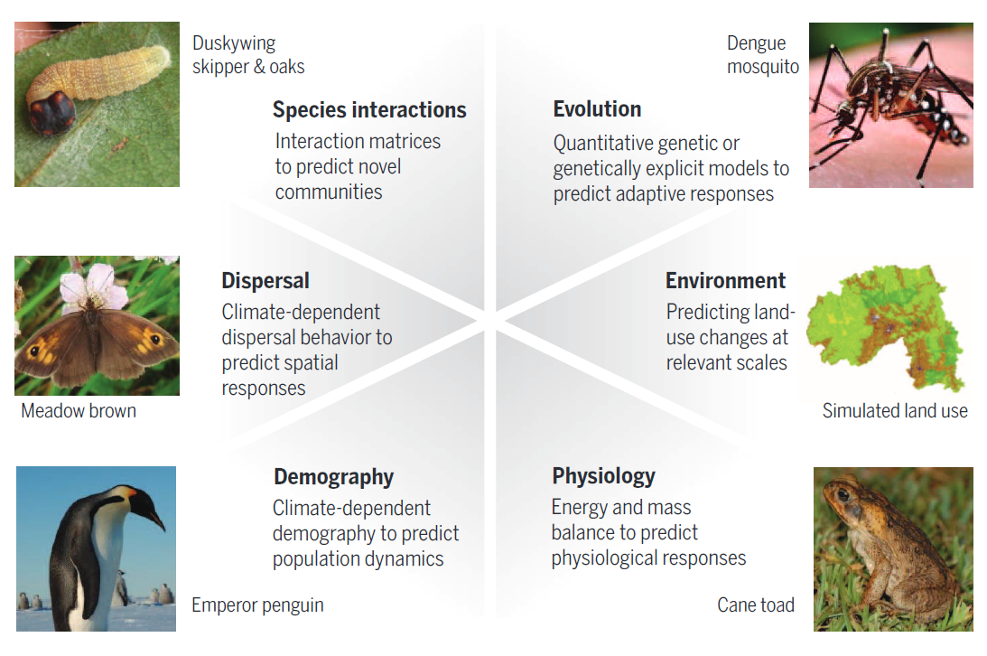
What is missing?
Urban et al., - Improving the forecast for biodiversity under climate change - 2016 - Science
Notes:
Something we are not going to include in the practical but is important to think about.
Models that include biological mechanisms have been used to project (clockwise from top) the evolution of disease-harboring mosquitoes, future environments and land use, physiological responses of invasive species such as cane toads, demographic responses of penguins to future climates, climate-dependent dispersal behavior in butterflies, and mismatched interactions between butterflies and their host plants. Despite thesemodelingadvances,we seldomhave the detailed data needed to build thesemodels, necessitating new efforts to collect the relevant data to parameterize more biologically realistic predictive models.

Slide 15
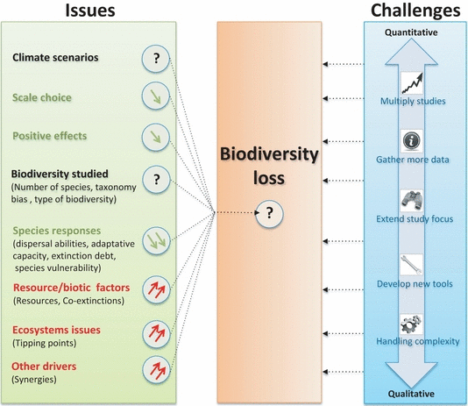
What is missing?
Bellard et al., 2012 - Impacts of climate change on the future of biodiversity - Ecology Letters
Notes:
Something we are not going to include in the practical but is important to think about.
Models that include biological mechanisms have been used to project (clockwise from top) the evolution of disease-harboring mosquitoes, future environments and land use, physiological responses of invasive species such as cane toads, demographic responses of penguins to future climates, climate-dependent dispersal behavior in butterflies, and mismatched interactions between butterflies and their host plants. Despite thesemodelingadvances,we seldomhave the detailed data needed to build thesemodels, necessitating new efforts to collect the relevant data to parameterize more biologically realistic predictive models.

Slide 16
Scenarios
“Scenarios” are representations of possible futures for one or more components of a system
e.g. for drivers of change in nature and nature’s benefits, including alternative policy or management options

Slide 17
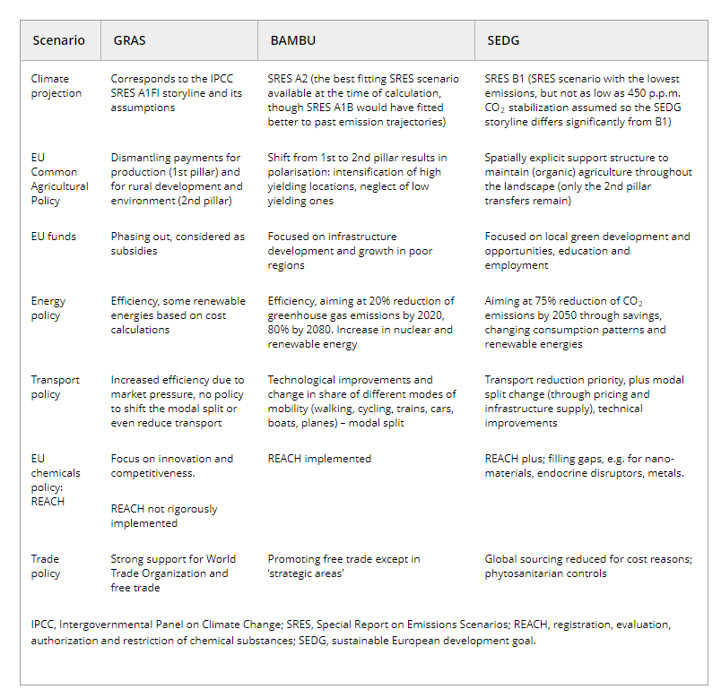
Storylines
Spangenberg et al., 2012 - Scenarios for investigating risks to biodiversity - Global Ecology and Biogeography

Slide 18
Storylines
Spangenberg et al., 2012 - Scenarios for investigating risks to biodiversity - Global Ecology and Biogeography

Slide 19
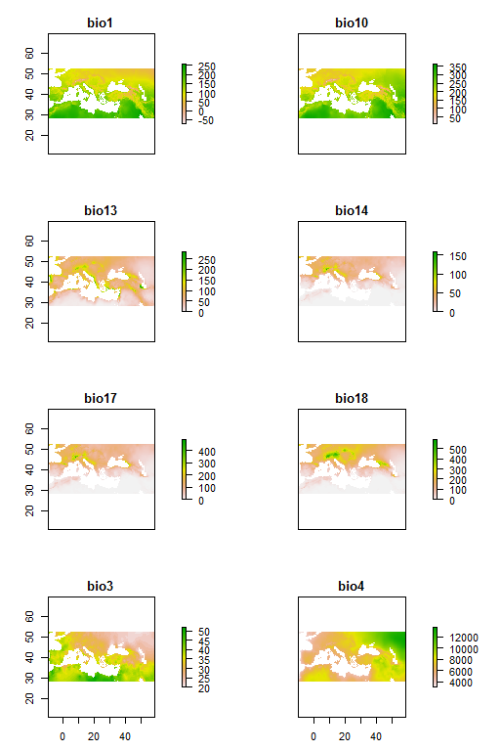
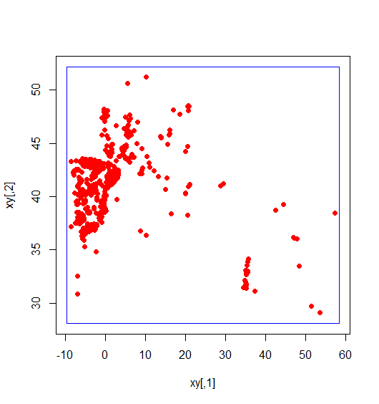
Species Data
What type of sampling?
Accuracy?
Full range of the species?
What is its current tolerance?

Slide 20
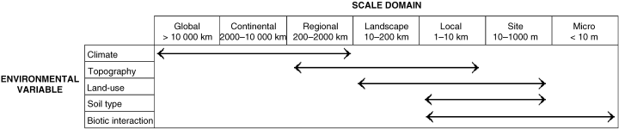
Variable Selection
Is this variable expected to change in the future?
Do you have modeled representations of this future variable?
At what scale are these variables?
Are these variables strongly correlated?
For what time periods are these variables available?

Slide 21
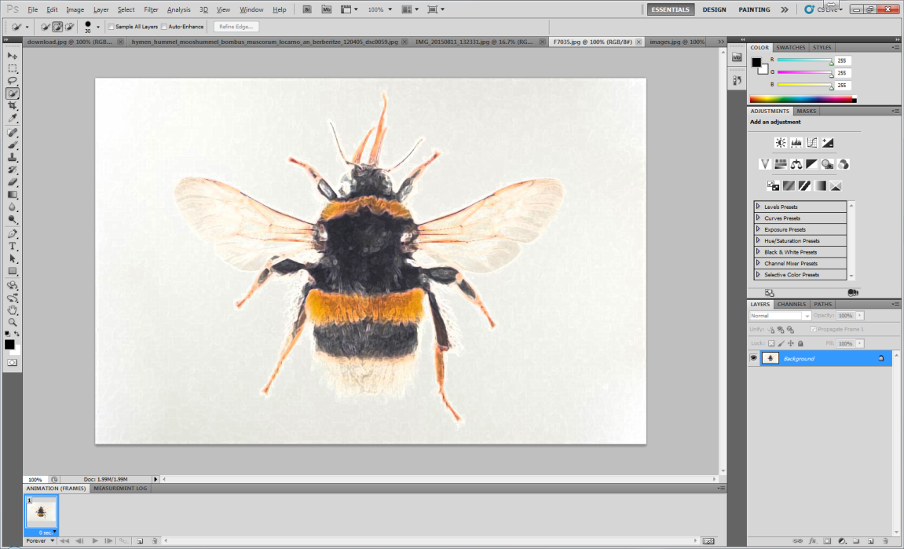
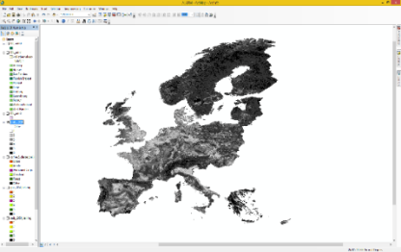
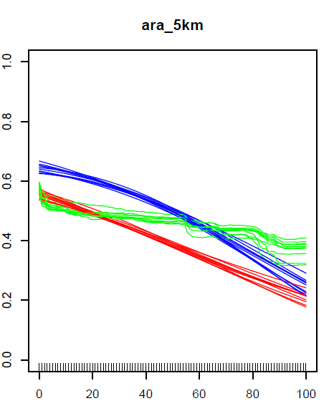
SDM - Training
+
+
Algorithms:
GLM
MAXENT
GBM
=
Bumblebee Collection Europe (48 Species)
European LU + Climate
ENSEMBLE

Slide 22
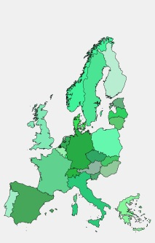

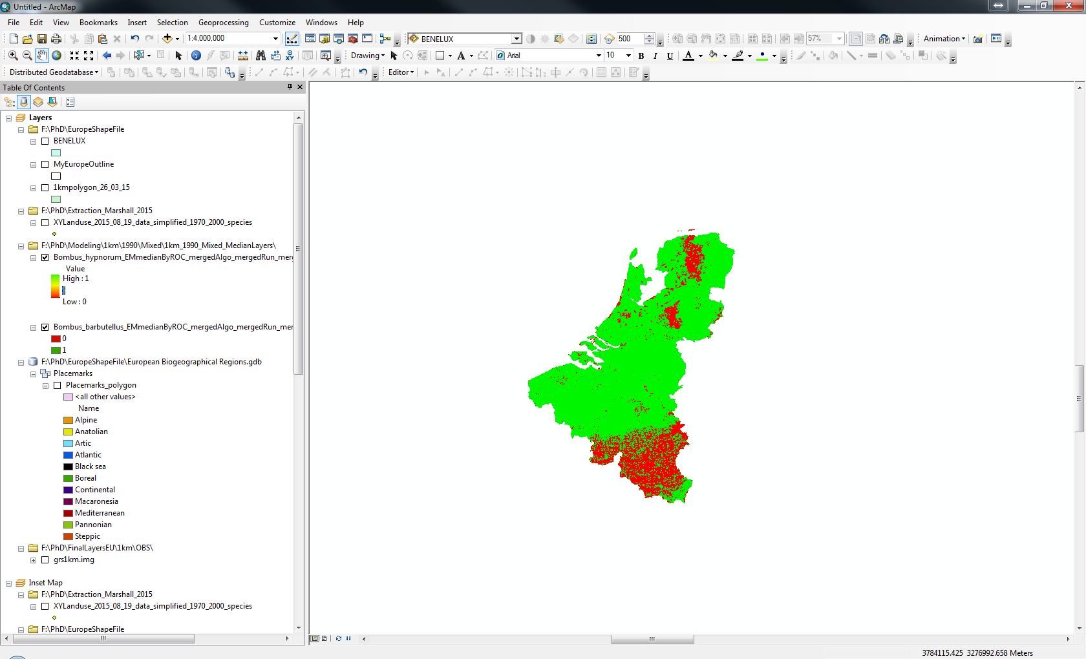
SDM - Projecting
Model Projections
Output
2000
Variable Contribution
Model Performance
Distribution Maps
Binary
Habitat Suitability
Results
Range Shifts
Range Change
BAMBU (2050 + 2100)
=
GRAS (2050 + 2100)
SEDG (2050 + 2100)

Slide 23
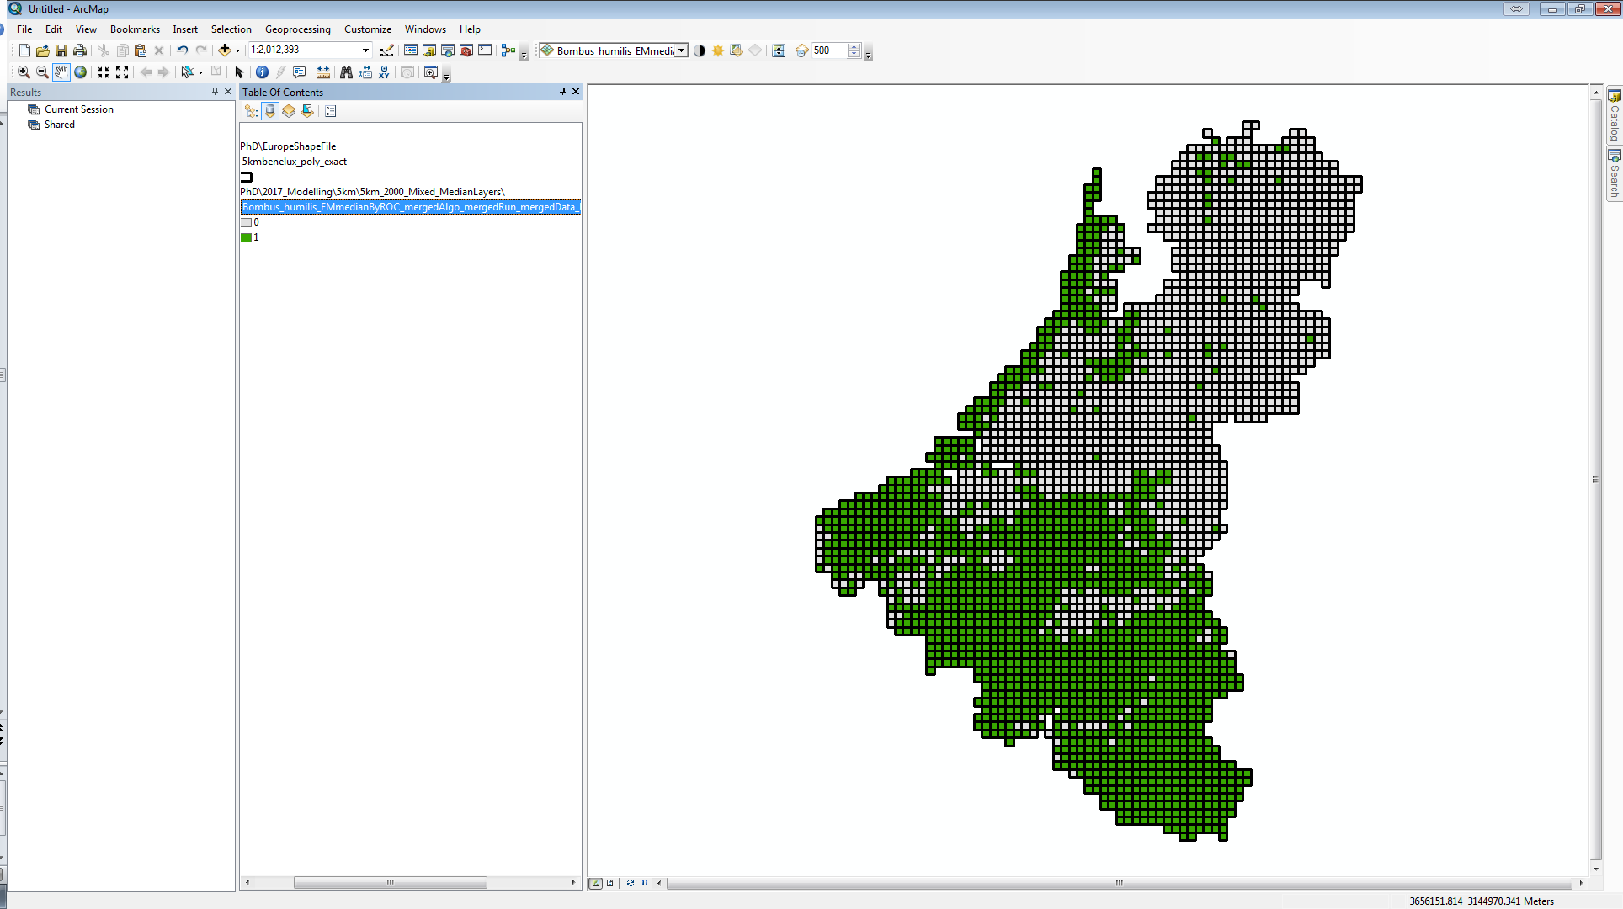
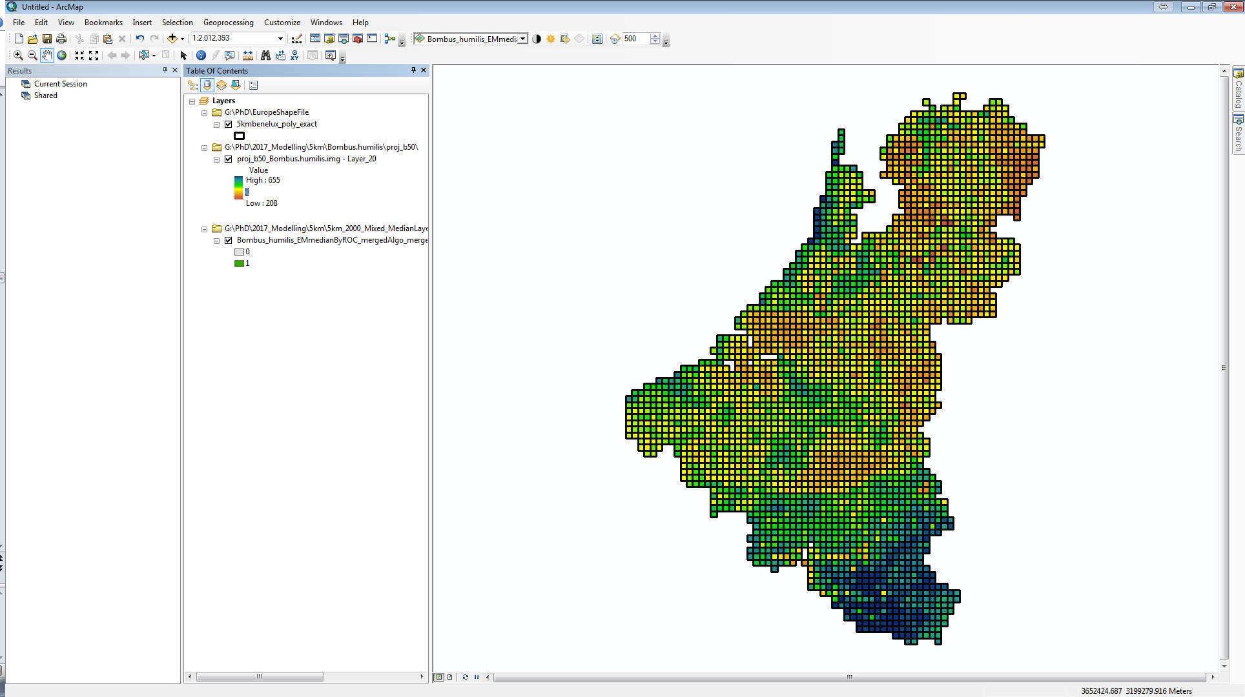
Measurements
Range change
Extinction
Shift in Suitable Habitat
Latitudinal and Longitudinal Shifts
Species richness change
Community composition
Conservation status (IUCN)

Slide 24
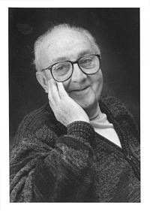
“all models are wrong, but some are useful”
- George E. P. Box
Notes:
Very important aspect of forecasting, there is a lot of uncertyainty
Four sources of uncertainty in niche-based SDM have been identified, including initial dataset conditions (IC), model classes (MC), model parameters (MP), and boundary conditions (BC) [10–12]. IC refers to an incomplete realization of species distribution (e.g. sample size [13,14], range size [15]). Projected changes in species range may differ substantially in both magnitude and direction due to the use of alternate MCs [2,11,16–18]. Predictions are also subject to MP selection. For instance, the two user-defined parameters of random forest (RF) (the number of trees and the number of randomly selected variables to split the nodes) should be optimized to improve predictive accuracy [19]. BC affects distribution projection because of future variations in climate caused by different global circulation models (GCM) and Special Report of Emission Scenarios (SRES) outcomes [15, 20–22].

Slide 25
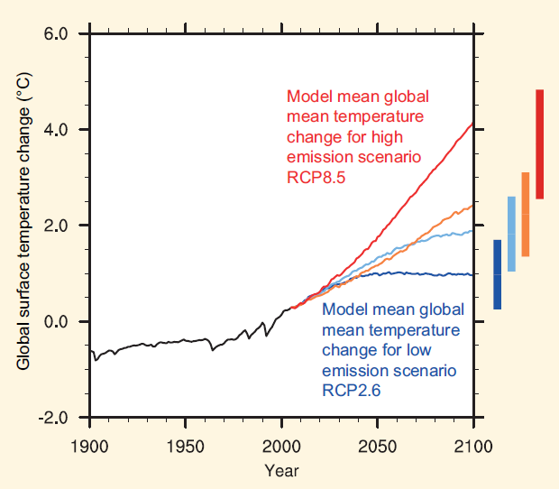
Uncertainty
Collection records
Sample size
Range size
Covariates
Different climate models
Covariate selection
Model
Algorithm
Parameter selection
IPCC, 2013
Notes:
Very important aspect of forecasting, there is a lot of uncertyainty
Four sources of uncertainty in niche-based SDM have been identified, including initial dataset conditions (IC), model classes (MC), model parameters (MP), and boundary conditions (BC) [10–12]. IC refers to an incomplete realization of species distribution (e.g. sample size [13,14], range size [15]). Projected changes in species range may differ substantially in both magnitude and direction due to the use of alternate MCs [2,11,16–18]. Predictions are also subject to MP selection. For instance, the two user-defined parameters of random forest (RF) (the number of trees and the number of randomly selected variables to split the nodes) should be optimized to improve predictive accuracy [19]. BC affects distribution projection because of future variations in climate caused by different global circulation models (GCM) and Special Report of Emission Scenarios (SRES) outcomes [15, 20–22].

Slide 26
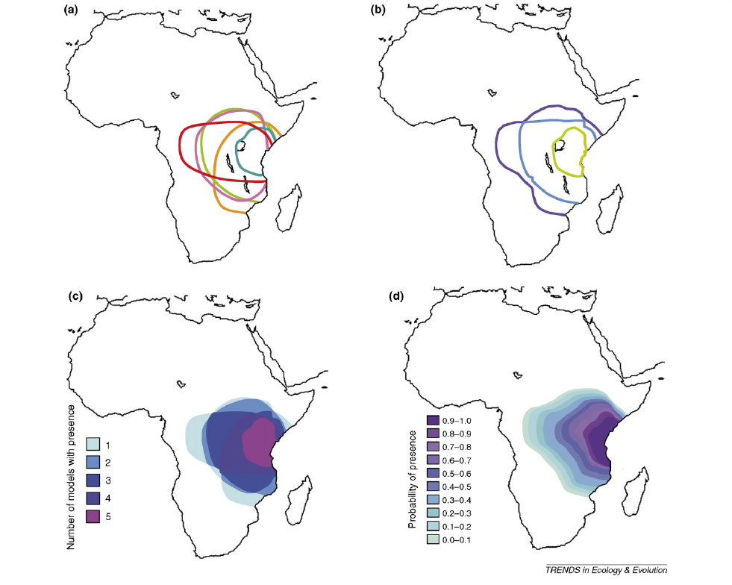
Uncertainty
Araujo et al., 2006 - Reducing uncertainty in projections of extinction risk from climate change - TREE
Notes:
Figure 1. Examples of alternative approaches to analysing ensemble forecasts using artificial data projected onto the map of Africa: (a) Individual results from five hypothetical bioclimatic models (shown by coloured lines) predicting the area occupied by a key species under a climate change scenario (no combination of the ensemble forecast is performed); (b) a bounding box showing the area where at least one (purple) or all models (green) predict species presence in the future, and a consensus forecast (blue) showing the area where at least half the models (the median) forecast species presence; (c) a frequency histogram, showing the number of models (1–5) forecasting the presence of the species at any point; and (d) a probability density function showing the likelihood of species presence estimated from a large ensemble.

Slide 27
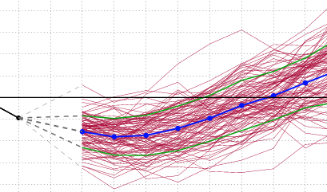
“The costs of being wrong can be high”
False positives and False negatives
Use many forecasts/models
Bounded forecasting (many)
Ensemble forecasting (one)
Notes:
So after all this uncertainty how do we actual begin to apply these biodiversity forecasts?

Slide 28
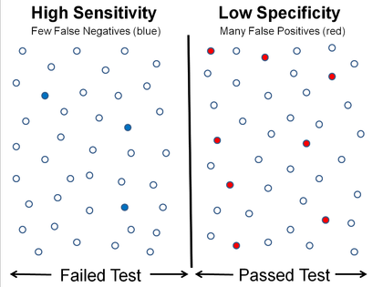
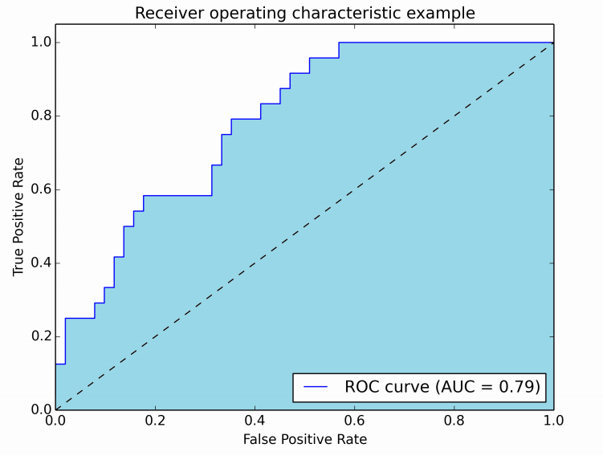
Evaluation
Field testing
Back-casting
Testing datasets – bootstrapping - AUC
Null model – difference from random
Notes:
Figure 1. Examples of alternative approaches to analysing ensemble forecasts using artificial data projected onto the map of Africa: (a) Individual results from five hypothetical bioclimatic models (shown by coloured lines) predicting the area occupied by a key species under a climate change scenario (no combination of the ensemble forecast is performed); (b) a bounding box showing the area where at least one (purple) or all models (green) predict species presence in the future, and a consensus forecast (blue) showing the area where at least half the models (the median) forecast species presence; (c) a frequency histogram, showing the number of models (1–5) forecasting the presence of the species at any point; and (d) a probability density function showing the likelihood of species presence estimated from a large ensemble.

Slide 29
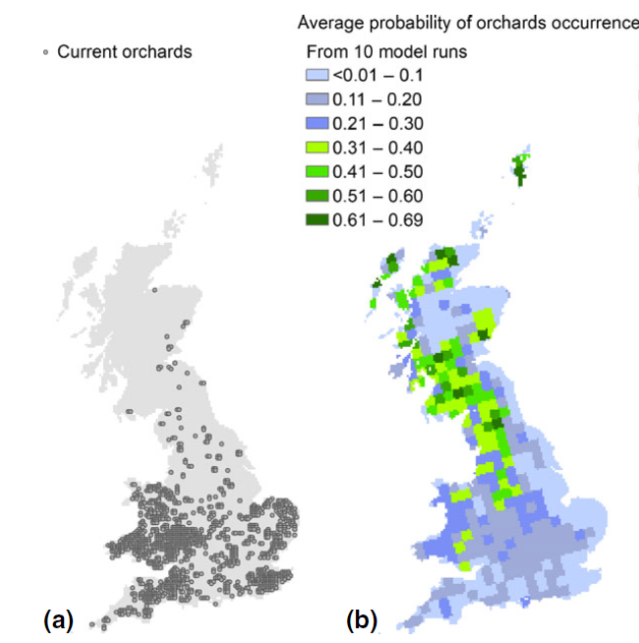
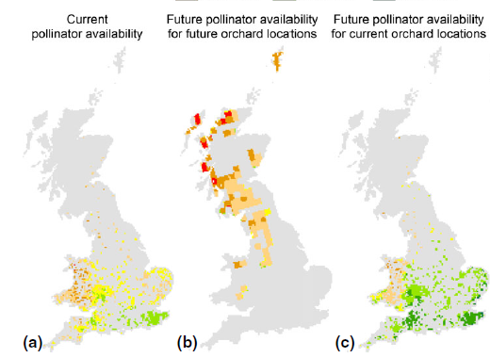
Application
Agriculture
Crop management
Polce et al., 2014 - Climate-driven spatial mismatches between British orchards and their pollinators: Increased risks of pollination deficits - Global Change Biology
Notes:
Short term versus long-term

Slide 30
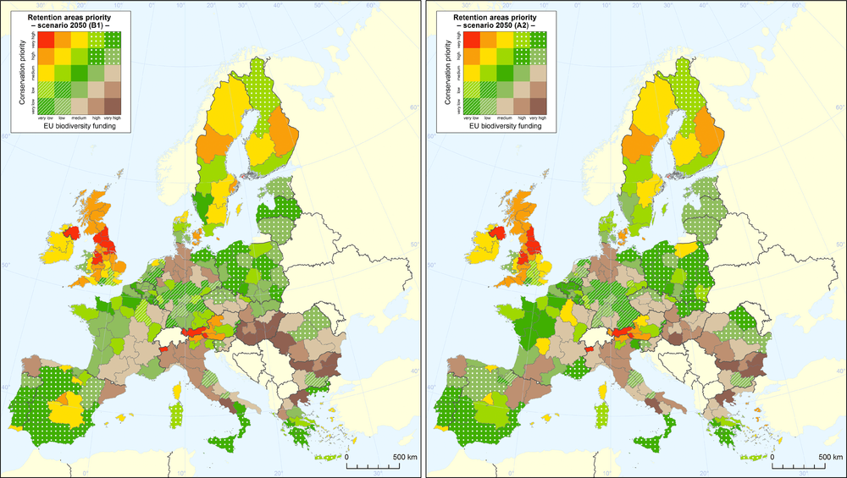
Application
Conservation Funding
Lung et al., 2014 - Biodiversity Funds and Conservation Needs in the EU Under Climate Change – Conservation Letters
Notes:
Short term versus long-term

Slide 31
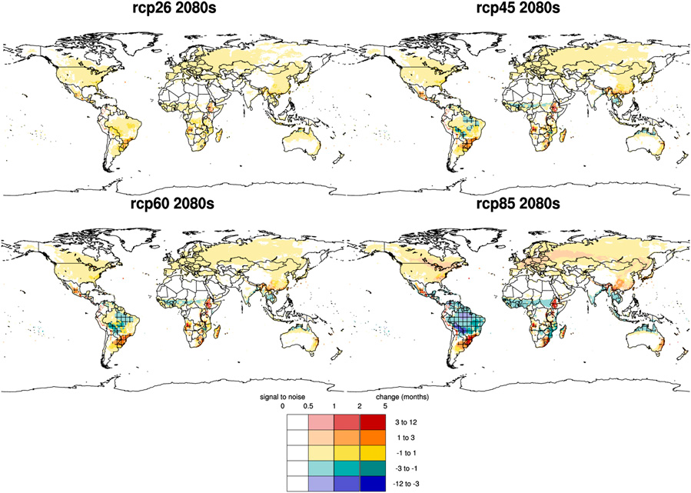
Application
Human health
Disease (E.g. Malaria)
Caminade et al., 2014 - Impact of climate change on global malaria distribution- PNAS
Notes:
Short term versus long-term

Slide 32
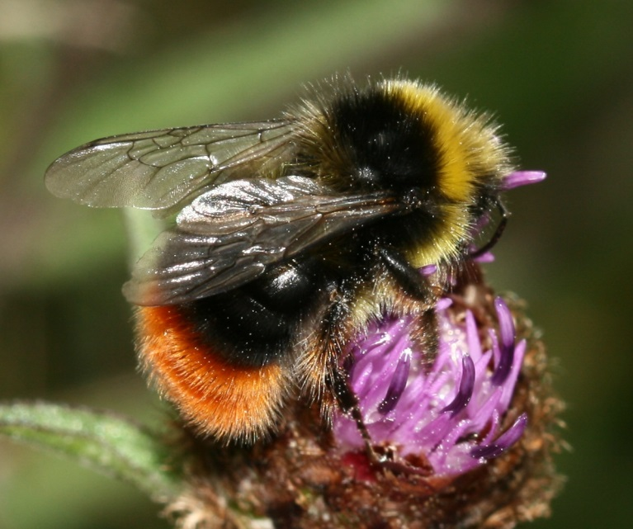
What about land use change?
Case Study: European Bumblebees

Slide 33
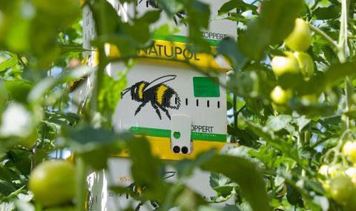
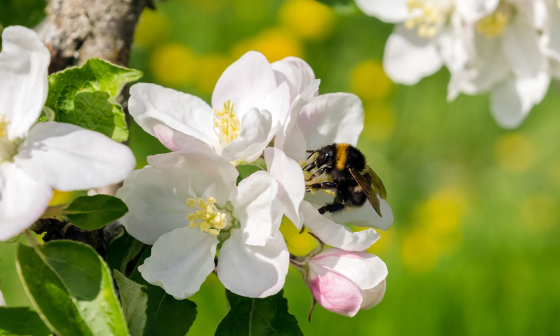
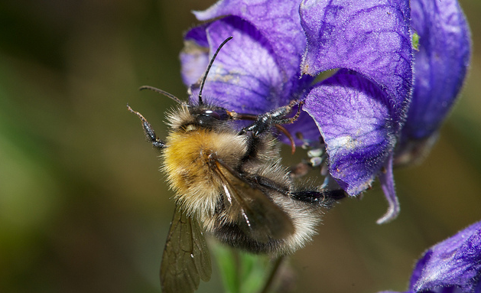
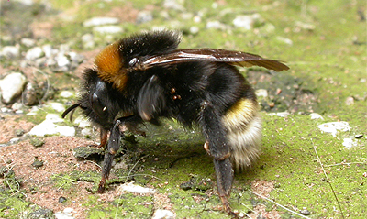
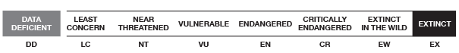

Slide 34
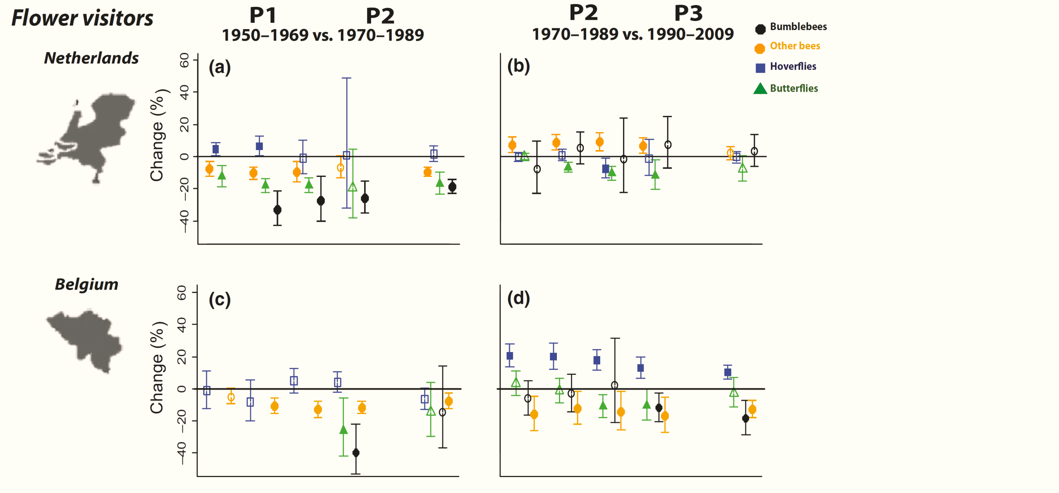
Insect decline in the Netherlands
Carvalheiro et al., 2013 - Species richness declines and biotic homogenisation have slowed down for NW-European pollinators and plants - Ecology Letters

Slide 35
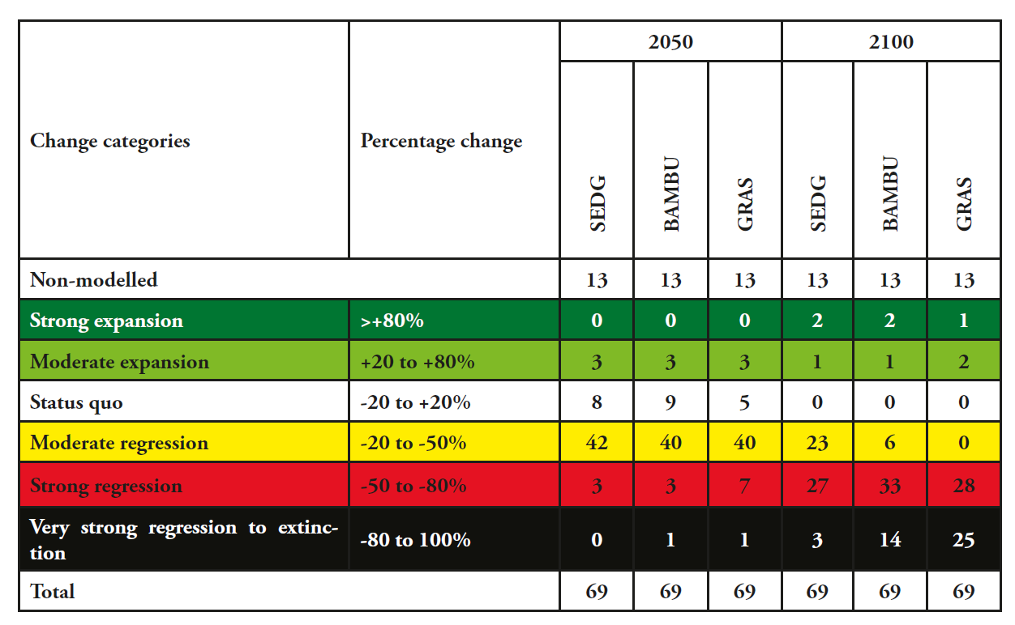
Climate Change + Bumblebees
Rasmont et al., 2015 - Climatic Risk and Distribution Atlas of European Bumblebees

Slide 36
How does change in major land use classes affect the projected distribution of Bumblebees predicted under climate change?

Slide 37
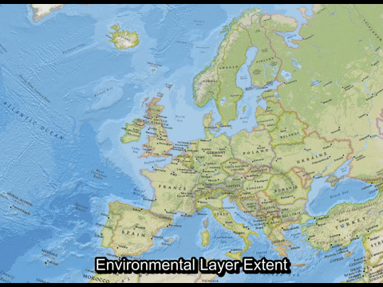

Slide 38

Sampling Bias
Bombus muscorum

Slide 39
Variable Selection
Arable
Forest
Grassland
Permanent crops
Urban
Growing degree days
Water balance
Temperature range
μ rainfall wettest month
μ diurnal range
1) Dynamic Climate Only
2) Static Land Use and Dynamic Climate
3) Dynamic Land Use and Dynamic Climate

Slide 40
Scenarios
ALARM Scenarios
BAMBU - ‘Business As Might Be Usual’ = A2
GRAS - ‘Growth Applied Strategy’ = A1F1
SEDG - ‘Sustainable European Development Goal’ = B1

Slide 41
SDM - Training
+
+
Algorithms:
GLM
MAXENT
GBM
=
Bumblebee Collection Europe (48 Species)
European LU + Climate
ENSEMBLE

Slide 42
SDM - Projecting
Model Projections
Output
2000
Variable Contribution
Model Performance
Distribution Maps
Binary
Habitat Suitability
Results
Range Shifts
Range Change
BAMBU (2050 + 2100)
=
GRAS (2050 + 2100)
SEDG (2050 + 2100)

Slide 43

High: 37
Low: 0
Climate Only
Present
Dynamic
Present

Slide 44
High: 37
Low: 0
Climate Only
BAMBU 2100
Dynamic
BAMBU 2100

Slide 45

Mixed Effect Model Results
Contrasts | BENELUX (20 × 20, 10 × 10, 5 × 5 km) |  |  |  |  | Europe (50 × 50 km)
 | Probability of Loss | Percentage Loss | Probability of Gain | Percentage Gain | Centroid Shift (km) | Percentage Loss | Percentage Gain | Centroid Shift (km)
COM – DLM | 0.13*** | 1.32*** | 0.30*** | 1.17 | -- | 1.17 | 1.62*** | 51.7***
COM – SLM | 0.34*** | 1.32*** | 0.58* | 1.45** | -- | 2.91*** | 1.97*** | 48.2***
DLM – SLM | 2.57** | 1 | 1.93*** | 1.24* | -- | 1.74* | 1.21** | -3.5
P-values: 0.01 ≤ p ≤ 0.05 = *, 0.001 ≤ p ≤ 0.01 =* * and <0.001 = ***

Slide 47
Conclusions
Large variability in species responses
Range loss
misrepresented by climate only models?
under-predicted with static land use models?
Species by species recommended
Dynamic land use models capture different habitat suitability envelope. Not simply level up or down.
More detailed future land use changes
Questions?

Slide 48

Practical
Rhinolophus euryale (Mediterranean horseshoe bat)

Slide 49

Species Data

Slide 50

Download Bioclims
5 minute resolution

Slide 51
Select Training Area
Clip environmental data by distribution of points

Slide 52


Variable Selection
Less than 0.7 correlation
Make selection based on ecology of species

Slide 53
Variable Selection
Scale and Save Selected Variables

Slide 54

MAXENT

Slide 55




OUTPUT

Slide 56



OUTPUT

Slide 57
Report
A 2-3 page report on a selected species
Introduction – about the species and its present distribution (from GBIF data)
Methodology
Which settings on MAXENT?
Variable selection
Which variables and why?
Model Output
Present + Future Distribution Map
Model performance – AUC (Good model or not?)
Variable Importance Table (What is driving the distribution patterns?)
Response to future scenario
Future Distribution Change Map
Biological interpretation
How is the distribution expected to change?
What could this mean for the biology of the species?
Is your model useful? Be critical!
What are the limitations?
What information is missing?

